Slide 1
Artificial Neural Networks

Slide 2
Agenda
History of Artificial Neural Networks
What is an Artificial Neural Networks?
How it works?
Learning
Learning paradigms
Supervised learning
Unsupervised learning
Reinforcement learning
Applications areas
Advantages and Disadvantages

Slide 3
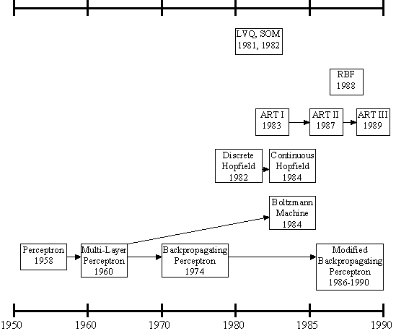
History of the Artificial Neural Networks
history of the ANNs stems from the 1940s, the decade of the first electronic computer.
However, the first important step took place in 1957 when Rosenblatt introduced the first concrete neural model, the perceptron. Rosenblatt also took part in constructing the first successful neurocomputer, the Mark I Perceptron. After this, the development of ANNs has proceeded as described in Figure.

Slide 4
History of the Artificial Neural Networks
Rosenblatt's original perceptron model contained only one layer. From this, a multi-layered model was derived in 1960. At first, the use of the multi-layer perceptron (MLP) was complicated by the lack of a appropriate learning algorithm.
In 1974, Werbos came to introduce a so-called backpropagation algorithm for the three-layered perceptron network.

Slide 5
History of the Artificial Neural Networks
in 1986, The application area of the MLP networks remained rather limited until the breakthrough when a general back propagation algorithm for a multi-layered perceptron was introduced by Rummelhart and Mclelland.
in 1982, Hopfield brought out his idea of a neural network. Unlike the neurons in MLP, the Hopfield network consists of only one layer whose neurons are fully connected with each other.

Slide 6
History of the Artificial Neural Networks
Since then, new versions of the Hopfield network have been developed. The Boltzmann machine has been influenced by both the Hopfield network and the MLP.

Slide 7
History of the Artificial Neural Networks
in 1988, Radial Basis Function (RBF) networks were first introduced by Broomhead & Lowe. Although the basic idea of RBF was developed 30 years ago under the name method of potential function, the work by Broomhead & Lowe opened a new frontier in the neural network community.

Slide 8
History of the Artificial Neural Networks
in 1982, A totally unique kind of network model is the Self-Organizing Map (SOM) introduced by Kohonen. SOM is a certain kind of topological map which organizes itself based on the input patterns that it is trained with. The SOM originated from the LVQ (Learning Vector Quantization) network the underlying idea of which was also Kohonen's in 1972.

Slide 9
History of Artificial Neural Networks
Since then, research on artificial neural networks has remained active, leading to many new network types, as well as hybrid algorithms and hardware for neural information processing.

Slide 10
Artificial Neural Network
An artificial neural network consists of a pool of simple processing units which communicate by sending signals to each other over a large number of weighted connections.

Slide 11
Artificial Neural Network
A set of major aspects of a parallel distributed model include:
a set of processing units (cells).
a state of activation for every unit, which equivalent to the output of the unit.
connections between the units. Generally each connection is defined by a weight.
a propagation rule, which determines the effective input of a unit from its external inputs.
an activation function, which determines the new level of activation based on the effective input and the current activation.
an external input for each unit.
a method for information gathering (the learning rule).
an environment within which the system must operate, providing input signals and _ if necessary _ error signals.

Slide 12
Computers vs. Neural Networks
“Standard” Computers Neural Networks
one CPU highly parallel processing
fast processing units slow processing units
reliable units unreliable units
static infrastructure dynamic infrastructure

Slide 13
Why Artificial Neural Networks?
There are two basic reasons why we are interested in building artificial neural networks (ANNs):
Technical viewpoint: Some problems such as character recognition or the prediction of future states of a system require massively parallel and adaptive processing.
Biological viewpoint: ANNs can be used to replicate and simulate components of the human (or animal) brain, thereby giving us insight into natural information processing.

Slide 14
Artificial Neural Networks
The “building blocks” of neural networks are the neurons.
In technical systems, we also refer to them as units or nodes.
Basically, each neuron
receives input from many other neurons.
changes its internal state (activation) based on the current input.
sends one output signal to many other neurons, possibly including its input neurons (recurrent network).

Slide 15
Artificial Neural Networks
Information is transmitted as a series of electric impulses, so-called spikes.
The frequency and phase of these spikes encodes the information.
In biological systems, one neuron can be connected to as many as 10,000 other neurons.
Usually, a neuron receives its information from other neurons in a confined area, its so-called receptive field.

Slide 16
Neural Network
Neural Network is a set of connected
INPUT/OUTPUT UNITS, where each connection has a WEIGHT associated with it.
Neural Network learning is also called CONNECTIONIST learning due to the connections between units.
It is a case of SUPERVISED, INDUCTIVE or CLASSIFICATION learning.

Slide 17
Neural Network
Neural Network learns by adjusting the weights so as to be able to correctly classify the training data and hence, after testing phase, to classify unknown data.
Neural Network needs long time for training.
Neural Network has a high tolerance to noisy and incomplete data

Slide 18
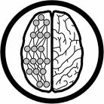
How do ANNs work?
An artificial neural network (ANN) is either a hardware implementation or a computer program which strives to simulate the information processing capabilities of its biological exemplar. ANNs are typically composed of a great number of interconnected artificial neurons. The artificial neurons are simplified models of their biological counterparts.
ANN is a technique for solving problems by constructing software that works like our brains.

Slide 19

How do our brains work?
The Brain is A massively parallel information processing system.
Our brains are a huge network of processing elements. A typical brain contains a network of 10 billion neurons.

Slide 20
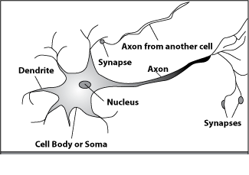
How do our brains work?
A processing element
Dendrites: Input
Cell body: Processor
Synaptic: Link
Axon: Output

Slide 21
How do our brains work?
A processing element
A neuron is connected to other neurons through about 10,000 synapses

Slide 22
How do our brains work?
A processing element
A neuron receives input from other neurons. Inputs are combined.

Slide 23
How do our brains work?
A processing element
Once input exceeds a critical level, the neuron discharges a spike ‐ an electrical pulse that travels from the body, down the axon, to the next neuron(s)

Slide 24
How do our brains work?
A processing element
The axon endings almost touch the dendrites or cell body of the next neuron.

Slide 25
How do our brains work?
A processing element
Transmission of an electrical signal from one neuron to the next is effected by neurotransmitters.

Slide 26
How do our brains work?
A processing element
Neurotransmitters are chemicals which are released from the first neuron and which bind to the
Second.

Slide 27
How do our brains work?
A processing element
This link is called a synapse. The strength of the signal that reaches the next neuron depends on factors such as the amount of neurotransmitter available.

Slide 28
Neural Network Classifier
Input: Classification data
It contains classification attribute
Data is divided, as in any classification problem.
[Training data and Testing data]
All data must be normalized.
(i.e. all values of attributes in the database are changed to contain values in the internal [0,1] or[-1,1])
Neural Network can work with data in the range of (0,1) or (-1,1)
Two basic normalization techniques
[1] Max-Min normalization
[2] Decimal Scaling normalization

Slide 29
Data Normalization
[1] Max- Min normalization formula is as follows:
[minA, maxA , the minimun and maximum values of the attribute A
max-min normalization maps a value v of A to v’ in the range {new_minA, new_maxA} ]

Slide 30
Example of Max-Min Normalization
Max- Min normalization formula
Example: We want to normalize data to range of the interval [0,1].
We put: new_max A= 1, new_minA =0.
Say, max A was 100 and min A was 20 ( That means maximum and minimum values for the attribute ).
Now, if v = 40 ( If for this particular pattern , attribute value is 40 ), v’ will be calculated as , v’ = (40-20) x (1-0) / (100-20) + 0
=> v’ = 20 x 1/80
=> v’ = 0.4

Slide 31
Decimal Scaling Normalization
[2]Decimal Scaling Normalization
Normalization by decimal scaling normalizes by moving the decimal point of values of attribute A.
Here j is the smallest integer such that max|v’|<1.
Example :
A – values range from -986 to 917. Max |v| = 986.
v = -986 normalize to v’ = -986/1000 = -0.986

Slide 32
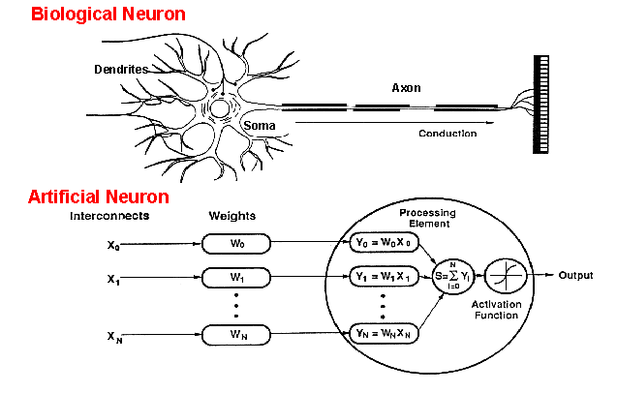
How do ANNs work?
An artificial neuron is an imitation of a human neuron

Slide 33
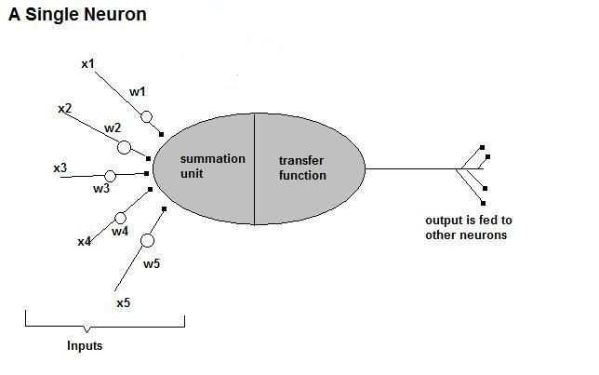
How do ANNs work?
• Now, let us have a look at the model of an artificial neuron.

Slide 34
How do ANNs work?
Input
xm
. . . . . . . . . . . .
x2
x1
Processing
∑
∑= X₁+X₂ + ….+X_{m} =y
Output
y

Slide 35

How do ANNs work?
Not all inputs are equal
xm
. . . . . . . . . . . .
x2
x1
Input
w_{m}
w₂
w₁
weights
. . . . .
Processing
∑
∑= X₁w₁+X₂w₂ + ….+X_{m}w_{m} =y
Output
y

Slide 36

How do ANNs work?
The signal is not passed down to the
next neuron verbatim
xm
. . . . . . . . . . . .
x2
x1
Input
w_{m}
w₂
w₁
weights
. . . . .
Processing
∑
Transfer Function (Activation Function)
f(v_{k})
Output
y

Slide 37
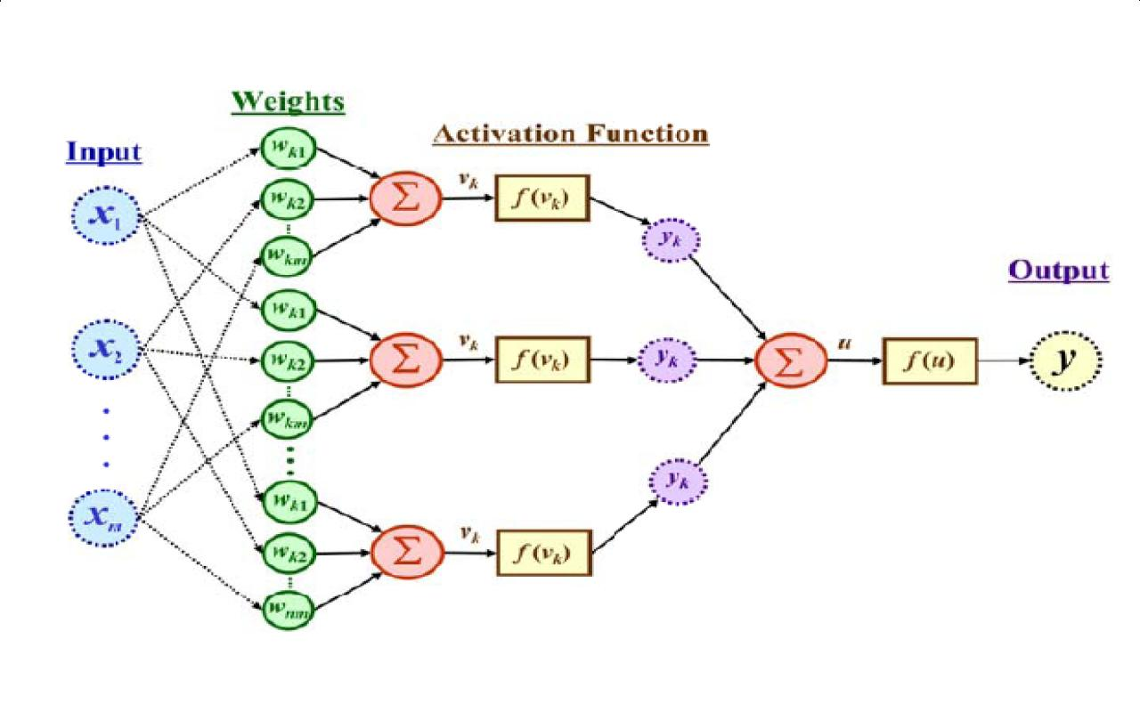
The output is a function of the input, that is affected by the weights, and the transfer functions

Slide 38
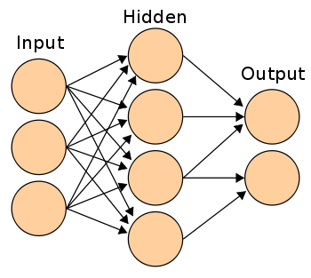
Three types of layers: Input, Hidden, and Output

Slide 39
Artificial Neural Networks
An ANN can:
compute any computable function, by the appropriate selection of the network topology and weights values.
learn from experience!
Specifically, by trial‐and‐error

Slide 40
Learning by trial‐and‐error
Continuous process of:
Trial:
Processing an input to produce an output (In terms of ANN: Compute the output function of a given input)
Evaluate:
Evaluating this output by comparing the actual output with the expected output.
Adjust:
Adjust the weights.

Slide 41
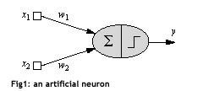
One Neuron as a Network
Here x1 and x2 are normalized attribute value of data.
y is the output of the neuron , i.e the class label.
x1 and x2 values multiplied by weight values w1 and w2 are input to the neuron x.
Value of x1 is multiplied by a weight w1 and values of x2 is multiplied by a weight w2.
Given that
w1 = 0.5 and w2 = 0.5
Say value of x1 is 0.3 and value of x2 is 0.8,
So, weighted sum is :
sum= w1 x x1 + w2 x x2 = 0.5 x 0.3 + 0.5 x 0.8 = 0.55

Slide 42
One Neuron as a Network
The neuron receives the weighted sum as input and calculates the output as a function of input as follows :
y = f(x) , where f(x) is defined as
f(x) = 0 { when x< 0.5 }
f(x) = 1 { when x >= 0.5 }
For our example, x ( weighted sum ) is 0.55, so y = 1 ,
That means corresponding input attribute values are classified in class 1.
If for another input values , x = 0.45 , then f(x) = 0,
so we could conclude that input values are classified to class 0.

Slide 43
Bias of a Neuron
We need the bias value to be added to the weighted sum ∑wixi so that we can transform it from the origin.
v = ∑wixi + b, here b is the bias
x1-x2= -1
x2
x1-x2=0
x1-x2= 1
x1

Slide 44
Bias as extra input
x₀ = +1
w₀
x₁
W1
Activation
function
v
Input
Attribute
values
Output
class
y
x₂
w₂
Summing function
x_{m}
w_{m}
weights

Slide 45
Neuron with Activation
The neuron is the basic information processing unit of a NN. It consists of:
1 A set of links, describing the neuron inputs, with weights W₁, W₂, …, W_{m}
2. An adder function (linear combiner) for computing the weighted sum of the inputs (real numbers):
3 Activation function : for limiting the amplitude of the neuron output.

Slide 46
Why We Need Multi Layer ?
Linear Separable:
Linear inseparable:
Solution?

Slide 47
A Multilayer Feed-Forward Neural Network
Output Class
Output nodes
Hidden nodes
w_{ij}
- weights
Input nodes
Network is fully connected
Input Record : x_{i}

Slide 48
Neural Network Learning
The inputs are fed simultaneously into the input layer.
The weighted outputs of these units are fed into hidden layer.
The weighted outputs of the last hidden layer are inputs to units making up the output layer.

Slide 49
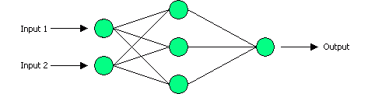
Example: XOR
Output Layer, with one neuron
Input Layer, with two neurons
Hidden Layer, with three neurons

Slide 50
How it works?
Output Layer, with one neuron
Input Layer, with two neurons
Hidden Layer, with three neurons

Slide 51
How it works?
Set initial values of the weights randomly.
Input: truth table of the XOR
Do
Read input (e.g. 0, and 0)
Compute an output (e.g. 0.60543)
Compare it to the expected output. (Diff= 0.60543)
Modify the weights accordingly.
Loop until a condition is met
Condition: certain number of iterations
Condition: error threshold

Slide 52
Design Issues
Initial weights (small random values ∈[‐1,1])
Transfer function (How the inputs and the weights are combined to produce output?)
Error estimation
Weights adjusting
Number of neurons
Data representation
Size of training set

Slide 53
Transfer Functions
Linear: The output is proportional to the total weighted input.
Threshold: The output is set at one of two values, depending on whether the total weighted input is greater than or less than some threshold value.
Non‐linear: The output varies continuously but not linearly as the input changes.

Slide 54
Error Estimation
The root mean square error (RMSE) is a frequently-used measure of the differences between values predicted by a model or an estimator and the values actually observed from the thing being modeled or estimated

Slide 55
Weights Adjusting
After each iteration, weights should be adjusted to minimize the error.
– All possible weights
– Back propagation

Slide 56
Back Propagation
Back-propagation is an example of supervised learning is used at each layer to minimize the error between the layer’s response and the actual data
The error at each hidden layer is an average of the evaluated error
Hidden layer networks are trained this way

Slide 57
A Multilayer Feed Forward Network
The units in the hidden layers and output layer are sometimes referred to as neurodes, due to their symbolic biological basis, or as output units.
A network containing two hidden layers is called a three-layer neural network, and so on.
The network is feed-forward in that none of the weights cycles back to an input unit or to an output unit of a previous layer.

Slide 58
A Multilayered Feed – Forward Network
INPUT: records without class attribute with normalized attributes values.
INPUT VECTOR: X = { x1, x2, …. xn}
where n is the number of (non class) attributes.
INPUT LAYER – there are as many nodes as non-class attributes i.e. as the length of the input vector.
HIDDEN LAYER – the number of nodes in the hidden layer and the number of hidden layers depends on implementation.

Slide 59
A Multilayered Feed–Forward Network
OUTPUT LAYER – corresponds to the class attribute.
There are as many nodes as classes (values of the class attribute).
k= 1, 2,.. #classes
Network is fully connected, i.e. each unit provides input
to each unit in the next forward layer.

Slide 60
Back Propagation
N is a neuron.
N_{w} is one of N’s inputs weights
N_{out} is N’s output.
N_{w} = N_{w} +Δ N_{w}
Δ N_{w} = N_{out} * (1‐ N_{out})* N_{ErrorFactor}
N_{ErrorFactor} = N_{ExpectedOutput} – N_{ActualOutput}
This works only for the last layer, as we can know the actual output, and the expected output.

Slide 61
Number of neurons
Many neurons:
Higher accuracy
Slower
Risk of over‐fitting
Memorizing, rather than understanding
The network will be useless with new problems.
Few neurons:
Lower accuracy
Inability to learn at all
Optimal number.

Slide 62
Data representation
Usually input/output data needs pre‐processing
Pictures
Pixel intensity
Text:
A pattern

Slide 63
Size of training set
No one‐fits‐all formula
Over fitting can occur if a “good” training set is not chosen
What constitutes a “good” training set?
Samples must represent the general population.
Samples must contain members of each class.
Samples in each class must contain a wide range of variations or noise effect.
The size of the training set is related to the number of hidden neurons

Slide 64
Learning Paradigms
Supervised learning
Unsupervised learning
Reinforcement learning

Slide 65
Supervised learning
This is what we have seen so far!
A network is fed with a set of training samples (inputs and corresponding output), and it uses these samples to learn the general relationship between the inputs and the outputs.
This relationship is represented by the values of the weights of the trained network.

Slide 66
Unsupervised learning
No desired output is associated with the training data!
Faster than supervised learning
Used to find out structures within data:
Clustering
Compression

Slide 67
Reinforcement learning
Like supervised learning, but:
Weights adjusting is not directly related to the error value.
The error value is used to randomly, shuffle weights!
Relatively slow learning due to ‘randomness’.

Slide 68
Classification by Back propagation
Back Propagation learns by iteratively processing a set of training data (samples).
For each sample, weights are modified to minimize the error between network’s classification and actual classification.

Slide 69
Steps in Back propagation Algorithm
STEP ONE: initialize the weights and biases.
The weights in the network are initialized to random numbers from the interval [-1,1].
Each unit has a BIAS associated with it
The biases are similarly initialized to random numbers from the interval [-1,1].
STEP TWO: feed the training sample.

Slide 70
Steps in Back propagation Algorithm ( cont..)
STEP THREE: Propagate the inputs forward; we compute the net input and output of each unit in the hidden and output layers.
STEP FOUR: back propagate the error.
STEP FIVE: update weights and biases to reflect the propagated errors.
STEP SIX: terminating conditions.

Slide 71
Propagation through Hidden Layer ( One Node )
-
Bias Θj
x₀
w_{0j}
x₁
w_{1j}
∑
f
output y
x_{n}
w_{nj}
Input
vector x
weight
vector w
weighted
sum
Activation
function
The inputs to unit j are outputs from the previous layer. These are multiplied by their corresponding weights in order to form a weighted sum, which is added to the bias associated with unit j.
A nonlinear activation function f is applied to the net input.

Slide 72
Propagate the inputs forward
For unit j in the input layer, its output is equal to its input, that is,
for input unit j.
The net input to each unit in the hidden and output layers is computed as follows.
Given a unit j in a hidden or output layer, the net input is
where wij is the weight of the connection from unit i in the previous layer to unit j; Oi is the output of unit I from the previous layer;
is the bias of the unit

Slide 73
Propagate the inputs forward
Each unit in the hidden and output layers takes its net input and then applies an activation function. The function symbolizes the activation of the neuron represented by the unit. It is also called a logistic, sigmoid, or squashing function.
Given a net input Ij to unit j, then
Oj = f(Ij),
the output of unit j, is computed as

Slide 74
Back propagate the error
When reaching the Output layer, the error is computed and propagated backwards.
For a unit k in the output layer the error is computed by a formula:
Where O k – actual output of unit k ( computed by activation function.
Tk – True output based of known class label; classification of training sample
Ok(1-Ok) – is a Derivative ( rate of change ) of activation function.

Slide 75
Back propagate the error
The error is propagated backwards by updating weights and biases to reflect the error of the network classification .
For a unit j in the hidden layer the error is computed by a formula:
where wjk is the weight of the connection from unit j to unit k in the next higher layer, and Errk is the error of unit k.

Slide 76
Update weights and biases
Weights are updated by the following equations, where l is a constant between 0.0 and 1.0 reflecting the learning rate, this learning rate is fixed for implementation.
Biases are updated by the following equations

Slide 77
Update weights and biases
We are updating weights and biases after the presentation of each sample.
This is called case updating.
Epoch --- One iteration through the training set is called an epoch.
Epoch updating ------------
Alternatively, the weight and bias increments could be accumulated in variables and the weights and biases updated after all of the samples of the training set have been presented.
Case updating is more accurate

Slide 78
Terminating Conditions
Training stops
All
in the previous epoch are below some threshold, or
The percentage of samples misclassified in the previous epoch is below some threshold, or
a pre specified number of epochs has expired.
In practice, several hundreds of thousands of epochs may be required before the weights will converge.

Slide 79
Backpropagation Formulas
Output vector
Output nodes
Hidden nodes
w_{ij}
Input nodes
Input vector: x_{i}

Slide 80
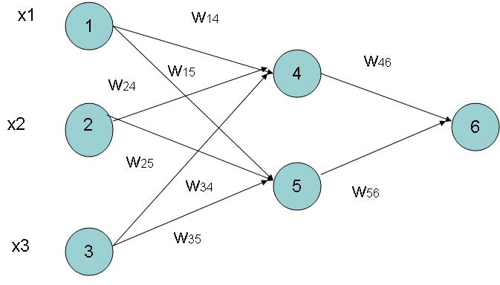
Example of Back propagation
Input = 3, Hidden Neuron = 2 Output =1
Initialize weights :
Random Numbers from -1.0 to 1.0
Initial Input and weight
x1 | x2 | x3 | w14 | w15 | w24 | w25 | w34 | w35 | w46 | w56
1 | 0 | 1 | 0.2 | -0.3 | 0.4 | 0.1 | -0.5 | 0.2 | -0.3 | -0.2

Slide 81
Example ( cont.. )
Bias added to Hidden
+ Output nodes
Initialize Bias
Random Values from
-1.0 to 1.0
Bias ( Random )
θ4 | θ5 | θ6
-0.4 | 0.2 | 0.1

Slide 82
Net Input and Output Calculation
Unitj | Net Input Ij | Output Oj
4 | 0.2 + 0 + 0.5 -0.4 = -0.7
5 | -0.3 + 0 + 0.2 + 0.2 =0.1
6 | (-0.3)0.332-(0.2)(0.525)+0.1= -0.105
= 0.332
= 0.525
= 0.475

Slide 83
Calculation of Error at Each Node
Unit j | Error j
6 | 0.475(1-0.475)(1-0.475) =0.1311 We assume T 6 = 1
5 | 0.525 x (1- 0.525)x 0.1311x (-0.2) = 0.0065
4 | 0.332 x (1-0.332) x 0.1311 x (-0.3) = -0.0087

Slide 84
Calculation of weights and Bias Updating
Learning Rate l =0.9
Weight | New Values
w46 | -0.3 + 0.9(0.1311)(0.332) = -0.261
w56 | -0.2 + (0.9)(0.1311)(0.525) = -0.138
w14 | 0.2 + 0.9(-0.0087)(1) = 0.192
w15 | -0.3 + (0.9)(-0.0065)(1) = -0.306
……..similarly | ………similarly
θ6 | 0.1 +(0.9)(0.1311)=0.218
……..similarly | ………similarly

Slide 85
Network Pruning and Rule Extraction
Network pruning
Fully connected network will be hard to articulate
N input nodes, h hidden nodes and m output nodes lead to h(m+N) weights
Pruning: Remove some of the links without affecting classification accuracy of the network

Slide 86
Advanced Features of Neural Network
Training with Subsets
Modular Neural Network
Evolution of Neural Network

Slide 87
Variants of Neural Networks Learning
Supervised learning/Classification
Control
Function approximation
Associative memory
Unsupervised learning or Clustering

Slide 88
Training with Subsets
Select subsets of data
Build new classifier on subset
Aggregate with previous classifiers
Compare error after adding classifier
Repeat as long as error decreases
Notes:
Error after adding each classifier compared against the previous error
– process repeats as long as the error decreases
He suggested two mechanisms for pasting votes
Pasting Rvotes (Random Votes)
Simple approach -- each example has equal probability of getting selected
A method for creating an ensemble classifier in a small number of passes through data
Pasting Ivotes (Important Votes)
Select the examples based on whether the out-of-bag classifier classifies them correctly
An out0of-bag classifier is constructed by first forming bootstrap training sets and
collecting the bagging predictor votes from the examples omitted by the bootstrap sample
Pasting Ivotes proves to be a more accurate method
Similarity – entire database is never in main memory at a time
Difference – we are able to use all of the data in building a single classifier
A single classifier – possibly a more accurate single classifier and faster too..
We also need only random access to the data on disk

Slide 89
Training with subsets
Subset 1
NN 1
Subset 2
NN 2
The
Whole
Dataset
Split the dataset
into subsets
that can fit
into memory
Subset 3
NN 3
.
.
.
Subset n
NN n
A Single
Neural Network
Model
Notes:
Break the data into subsets, that can fit in memory
Train one neural network on a series of the subsets
The result is a single neural network model
In this way, we attempt to overcome the difficulty addressed by catlett,
making use of all the available data, without leaving anything

Slide 90
Modular Neural Network
Modular Neural Network
Made up of a combination of several neural networks.
The idea is to reduce the load for each neural network as opposed to trying to solve the problem on a single neural network.
Notes:
Error after adding each classifier compared against the previous error
– process repeats as long as the error decreases
He suggested two mechanisms for pasting votes
Pasting Rvotes (Random Votes)
Simple approach -- each example has equal probability of getting selected
A method for creating an ensemble classifier in a small number of passes through data
Pasting Ivotes (Important Votes)
Select the examples based on whether the out-of-bag classifier classifies them correctly
An out0of-bag classifier is constructed by first forming bootstrap training sets and
collecting the bagging predictor votes from the examples omitted by the bootstrap sample
Pasting Ivotes proves to be a more accurate method
Similarity – entire database is never in main memory at a time
Difference – we are able to use all of the data in building a single classifier
A single classifier – possibly a more accurate single classifier and faster too..
We also need only random access to the data on disk

Slide 91
Evolving Network Architectures
Small networks without a hidden layer can’t solve problems such as XOR, that are not linearly separable.
Large networks can easily overfit a problem to match the training data, limiting their ability to generalize a problem set.

Slide 92
Constructive vs Destructive Algorithm
Constructive algorithms take a minimal network and build up new layers nodes and connections during training.
Destructive algorithms take a maximal network and prunes unnecessary layers nodes and connections during training.

Slide 93
Training Process of the MLP
The training will be continued until the RMS is minimized.
ERROR
Local Minimum
Local Minimum
Global Minimum
W (N dimensional)

Slide 94
Faster Convergence
Back prop requires many epochs to converge
Some ideas to overcome this
Stochastic learning
Update weights after each training example
Momentum
Add fraction of previous update to current update
Faster convergence
Notes:
An epoch is one presentation of all the training examples in the dataset
Stochastic learning
Updates weights after each example, instead of updating them after one epoch
Momentum term
This optimization is due to the fact that it speeds up the learning when the weights
are moving in a single direction continuously by increasing the size of steps
The closer this value is to one, the more each weight change will not only include
the current error, but also the weight change from previous examples
(which often leads to faster convergence)

Slide 95
Applications Areas
Function approximation
including time series prediction and modeling.
Classification
including patterns and sequences recognition, novelty detection and sequential decision making.
(radar systems, face identification, handwritten text recognition)
Data processing
including filtering, clustering blinds source separation and compression.
(data mining, e-mail Spam filtering)

Slide 96
Advantages / Disadvantages
Advantages
Adapt to unknown situations
Powerful, it can model complex functions.
Ease of use, learns by example, and very little user domain‐specific expertise needed
Disadvantages
Forgets
Not exact
Large complexity of the network structure

Slide 97
Summary
We presented mainly the followings-------
Basic building block of Artificial Neural Network.
Construction , working and limitation of single layer neural network (Single Layer Neural Network).
Back propagation algorithm for multi layer feed forward NN.
Some Advanced Features like training with subsets, Quicker convergence, Modular Neural Network, Evolution of NN.
Application of Neural Network.

Slide 98
Remember…..
ANNs perform well, generally better with larger number of hidden units
More hidden units generally produce lower error
Determining network topology is difficult
Choosing single learning rate impossible
Difficult to reduce training time by altering the network topology or learning parameters
NN(Subset) often produce better results

Slide 99
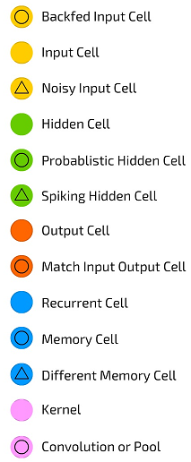
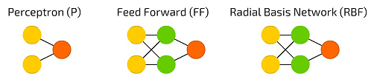
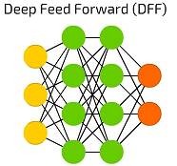
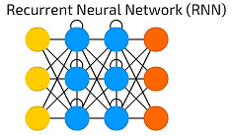
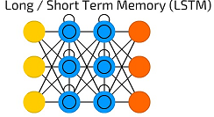
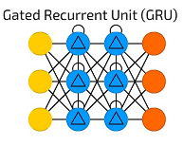
Neural Network web

Slide 100
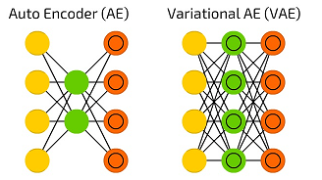
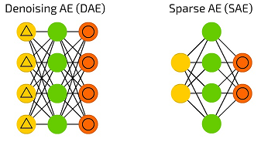
Neural Network web

Slide 101
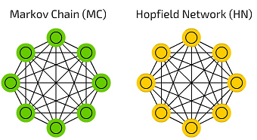
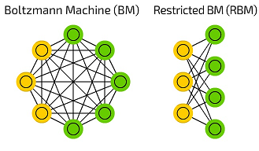
Neural Network web

Slide 102
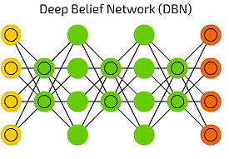
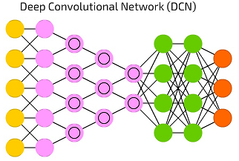
Neural Network web

Slide 103
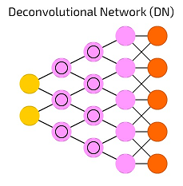
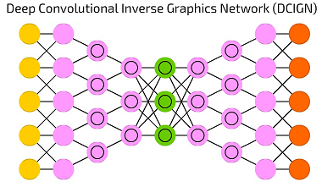
Neural Network web

Slide 104
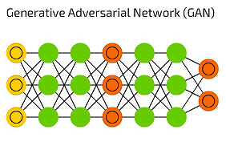
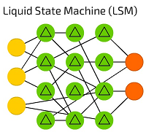
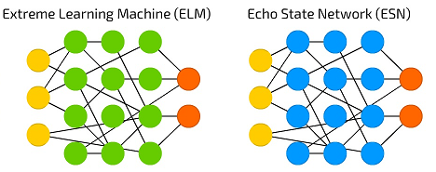
Neural Network web

Slide 105
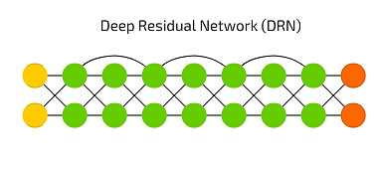
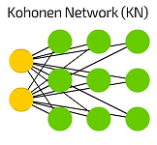
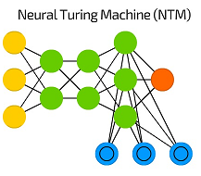
Neural Network web

